Slide 1
THE SFS
PROPOSAL
PERPUSTAKAAN KANAK KANAK INTERACTIVE WEB APPLICATION

Slide 2
GOAL
Our goal is to develop an interactive and informative web-based application that will be a counteract for the problems faced by the library.

Slide 3
OBJECTIVES
To increase the number of visitor from students and kindergarten kids by creating an interactive quiz which requires them to go to library to solve for answers. This will improve the number of visitors up to 20% per month.
To provide an effective communication between library and community by including informative portal that allows user to follow up any events that will be held at the library. As a result, it will increase the participation from community with the percentage of 25% per month.
To improve the involvement of community in crowdfunding through the portal. People can donate books and funds to the library if they have registered into the system. This will increase the level of conducive up to 30% per year.

Slide 4
SCOPE
INTERACTIVE
INFORMATIVE

Slide 5
Interactive
There will be an online based quiz competition which will involve the competitors to come to the library and read the books to get answer for the questions. They will have to key in the answer along with the book name and page number. Once sent, the answer will be validated and score will be updated by the application admin. They can see their scores and ranking after the end of the competition on every week\month.

Slide 6
Informative
The application will act as a platform for the library to spread information about the activities and events that will take place at the library. People will easily get the details of events that are going to be held at the website. The information page of the website will consist of events taking place at the library and user can click on any event to get more details. It was hard previously and many people couldn’t be notified as for the manual system. This will increase the number of visitors of the library.

Slide 7
USER
The target users of our application :
Visitors of the library (children, parents, students etc..)
Application administrator
Staff

Slide 8
MOTIVATION
During the previous site visit, we noticed that there are few numbers of visitors who come to the library. After interviewing some of the visitors, we found that some of them have lost their interest to come to the library as they rely on their smartphone more to get any information. The system of the library is not interesting enough to make them come to the library.

Slide 9
FUNCTIONAL REQUIREMENTS
GENERAL
ID | Description
G1 | A server shall host the application and provide system data processing and storage capability.
G2 | The system shall able the user to interact with their functionality
STUDENT
ID | Description
S1 | Student shall be able to register into the system.
S2 | Student shall able to log in to the system using username and password.
S3 | Student should able to enter the quiz page to answer the quizzes.
S4 | Student shall able to submit the entire quiz and the system shall store the data into the database.
S5 | Student shall save their answer and load it again even after the re-login
S6 | Student shall be able to view the result of the quiz

Slide 10
COMMUNITY
ID | Description
C1 | Community shall be able to receive announcement pop-up message once they enter the portal.
C2 | Community shall be able to register into the system.
C3 | Community shall be able to login to the system.
C4 | Only registered community can participate in the event conducted.
C5 | The system shall record the community involvement in the profile.
C6 | Community shall be able to view their profile and activity.
C7 | Community shall be able to give feedback to the system.

Slide 11
STAFF
ID | Description
S1 | Staff shall be able to log in to the system.
S2 | Staff shall be able to register into the system.
S3 | Staff shall able to view the completed quiz.
S4 | Staff should have the authority to evaluate each quizzes
S5 | Staff shall be able to view the result of the quiz.
S6 | Staff shall be able to give feedbacks to the quiz.
S7 | Staff shall be able to receive feedback from student and community.
S8
ADMIN
ID | Description
A1 | Admin shall be able to upload announcement to the portal
A2 | Admin shall able to manage the registered user.
A3 | Admin should be able to view all admin menus.

Slide 12
NON-FUNCTIONAL REQUIREMENTS
TYPE | SPESIFICATION
Availability | The system is available 100% for the user and is used within the working hour.
Efficiency | Even if the system fails, the system will be recovered back up within an hour or less.
Accuracy | The system shall provide 100% accuracy while transferring data between server and user.
Performance | The information is refreshed at regular intervals depending upon whether some updates have occurred or not. The system shall respond to the member in not less than two seconds from the time of the request submittal.
Usability | The system is user friendly and online, which will help to make the system to use easily. The system will support multiple language such as English and Malay. The system is easy to use and user can understand the functions easily.
Security | A user password used for the computer must be changed every three month. A user that attempts to log into other pc while already logged into another pc shall be rejected and notified through the pc.

Slide 13
PROTOTYPE

Slide 14
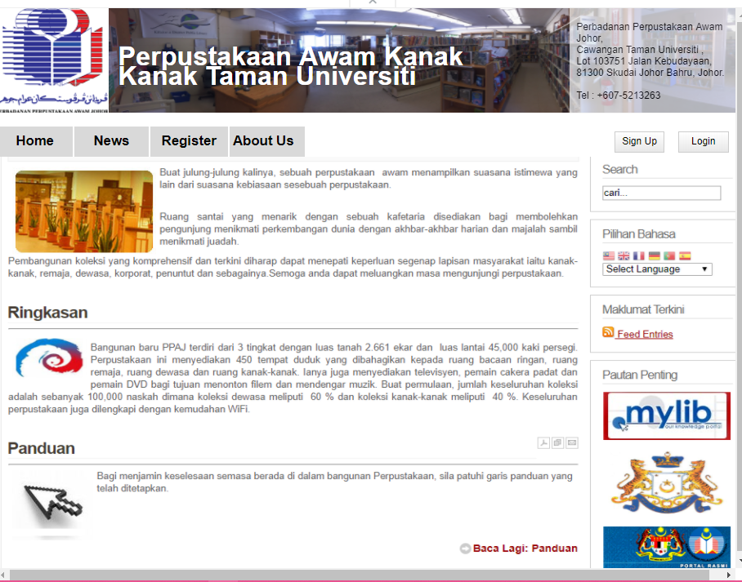
Main Page

Slide 15
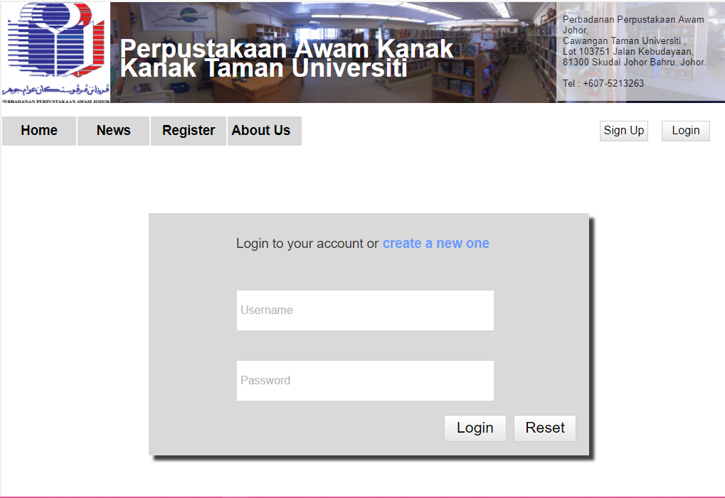
Log In

Slide 16
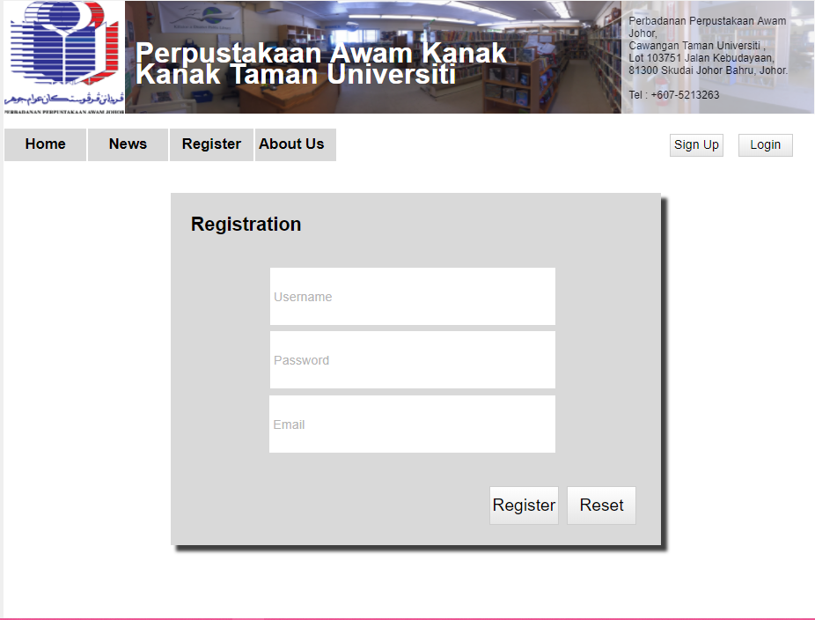
Registration

Slide 17
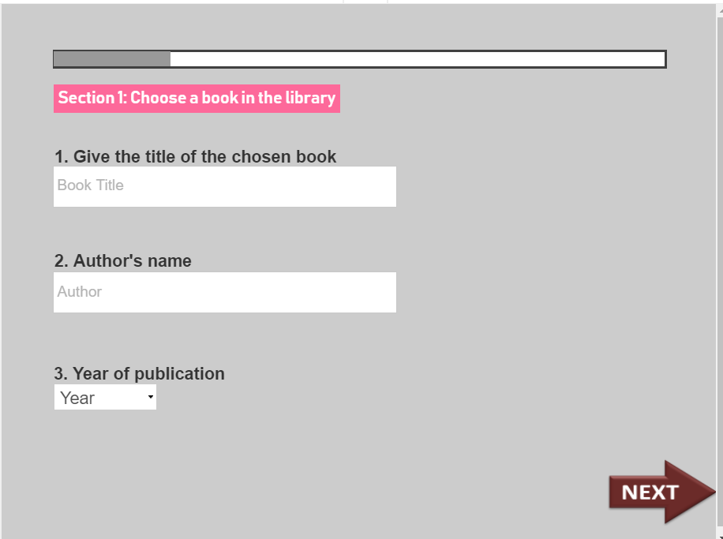
Quiz

Slide 18
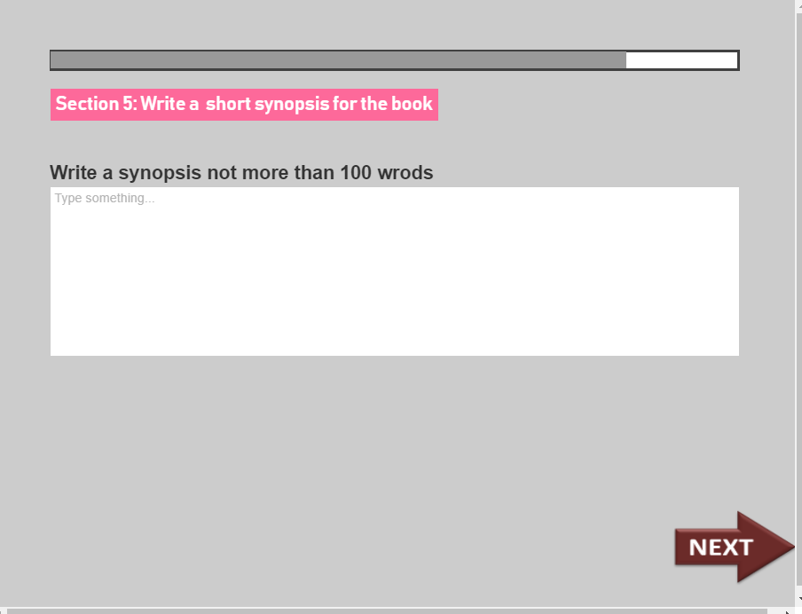

Slide 19
USER REQUIREMENT SPECIFICATION
Use Case Model.png
State Diagram.png
Class Diagram.png
Logical Database Model.png

Slide 20
ACTIVITY DIAGRAM
Activity Register.png
Activity Manage Profile.png
Activity Login.png
Activity Complete Quizzes.png
Activity Register Event.png
Activity Review Feedback.pdf
Activity View Result.png
Activity Send Feedback.png
Activity Evaluate Quiz.pdf

